Slide 1
Synthetic Data Generation and Sandbox
Team “Trojan Horses”

Slide 2
Table Of Contents
Overview
Problem Statement
Project Goals
Why Synthetic Data?
Design & Approach
Implementation Details
How DataSynthesizer Works?
DataSynthesizer Prototype
Sandbox Setup Steps
Benefits

Slide 3
Overview
Currently test data is being created by taking production backups and applying masking on known sensitive PI information. There could still be customer information available on lower environments which can lead to data privacy issues. Creating test data is a costly, time consuming activity, also the data cannot be moved to cloud servers due to data residency limitations.
Objective of this project is to generate synthetic test data that is similar to our production data for different domains, hence paving the way for sandbox virtualization (or mock test environment).

Slide 4
Project Goals
01
Generate Synthetic Data at low cost: Generate domain specific synthetic data based on existing data structure.
02
Spin up new test environments faster and cheaper: Use the generated data for creating virtualized/mock environments for sandbox testing
03
Data Sharing without compromising on privacy: Share data sets for Dev, UAT and vendor teams without risking data privacy. Also the data can be ported to any cloud regions.

Slide 5
Why Synthetic Data?
Testing —synthetic test data is easier to generate than rule-based test data and provides flexibility, scalability, and realism. This data is essential for data-driven testing and software development.
AI/ML model training —AI model training increasingly relies on synthetic data. Data synthesis can augment real data and upsample rarer events or patterns, enabling the algorithm to train more effectively. Synthetic training data typically performs better than real-world data and is crucial for building high-quality AI models.
Governance – synthetic data helps remove biases present in real-world data. Synthetic data is also useful for stress-testing an AI model with data points that rarely occur in the real world. Synthetic data is essential for explainable AI and provides insights into how models behave.

Slide 6
Design & Approach
We are using Bayesian Networks Model to Create Synthetic Data
Bayesian Network or Bayes Network is a generative probabilistic graphical model of the joint probability distribution for a set of variables.
A Bayesian network could be used to create multiple synthetic data sets that are then released by an official statistics agency while the original data remain confidential.

Slide 7
Implementation Details
We have implemented Bayesian Networks Model using DataSynthesizer python package
DataSynthesizer consists of three modules (DataDescriber, DataGenerator, and ModelInspector).
DataDescriber computes the statistics of the dataset and saves that metadata in a local file which is later used in the data generation step.
DataGenerator generates a synthetic dataset based on user parameters and the data description file.
The final module is ModelInspector, which compares the original and synthetic datasets using histograms, as well as compares pairwise correlations.

Slide 8
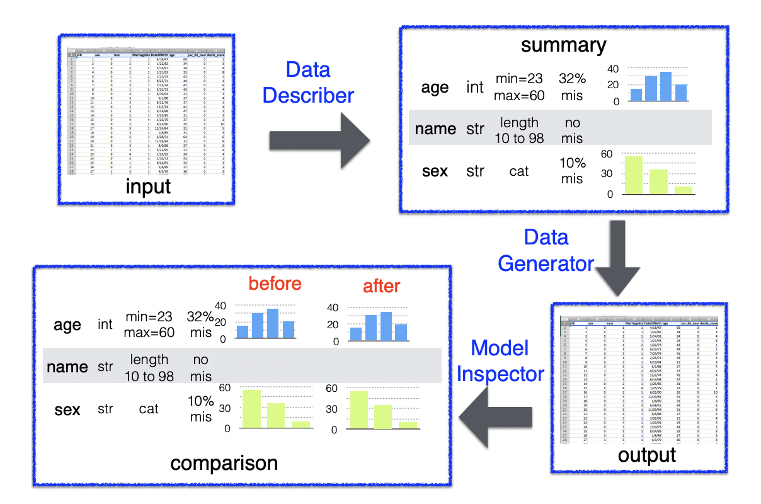
How DataSynthesizer Works?

Slide 9
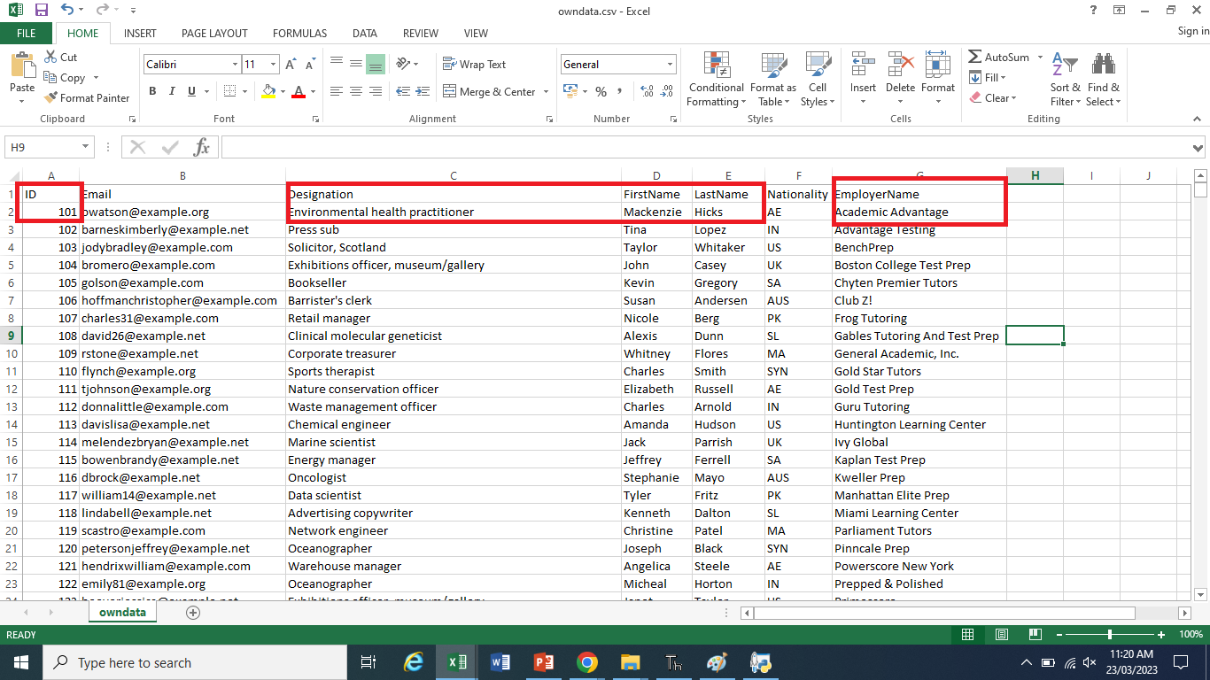
DataSynthesizer - Prototype - Input
● We are going to create synthetic data in the below highlighted dataset fields and this is the input file to train the program.

Slide 10
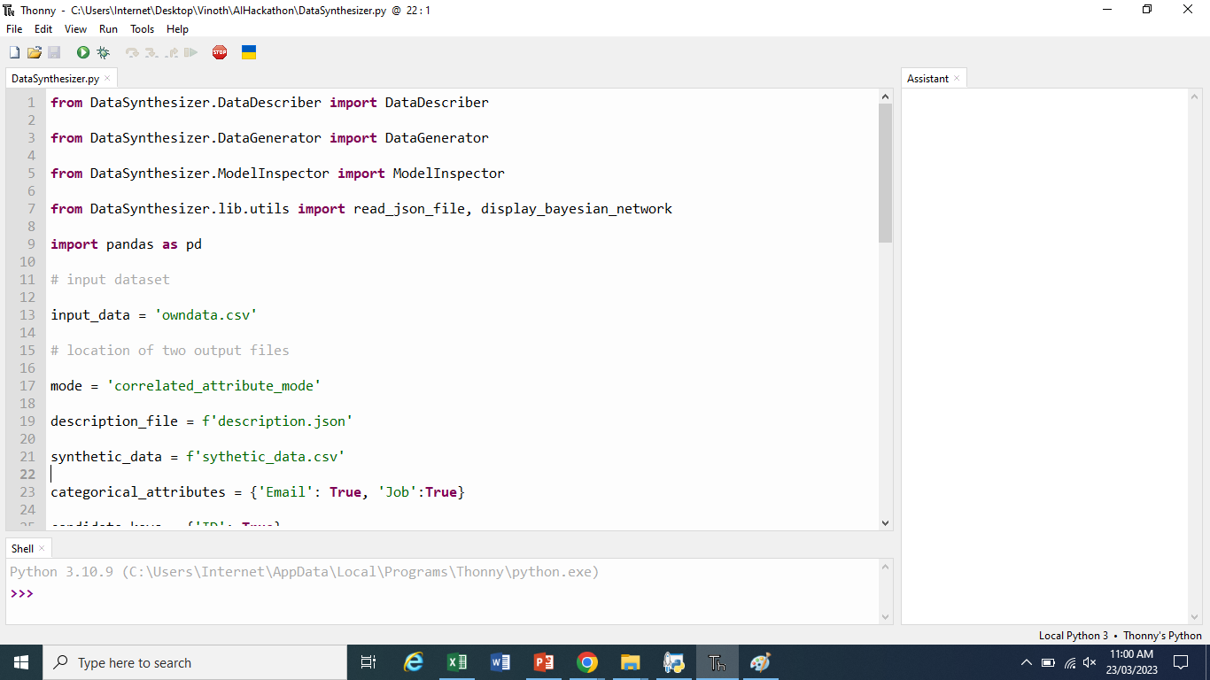
DataSynthesizer - Prototype - Code
● Screenshot of the Source code where we are generating synthetic data

Slide 11
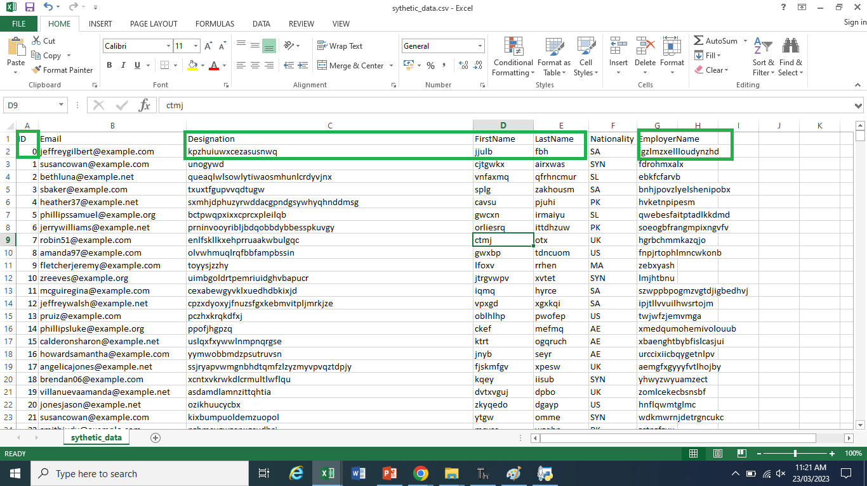
DataSynthesizer - Prototype - Output
● This is the final output file where we have created 10000 synthetic records. The highlighted synthetic dataset fields are generated.
● The data accuracy/completeness can be improved drastically by integrating with faker package which can generate realistic names, account numbers, IBAN numbers, etc. .

Slide 12
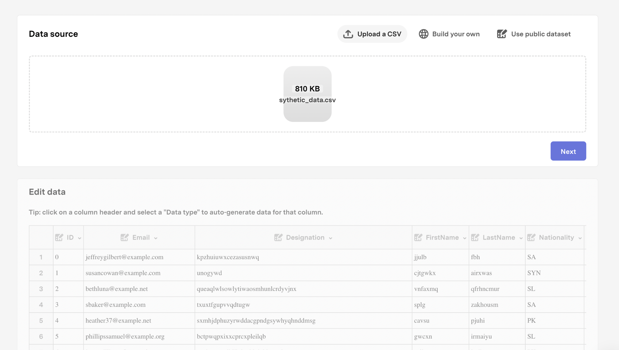
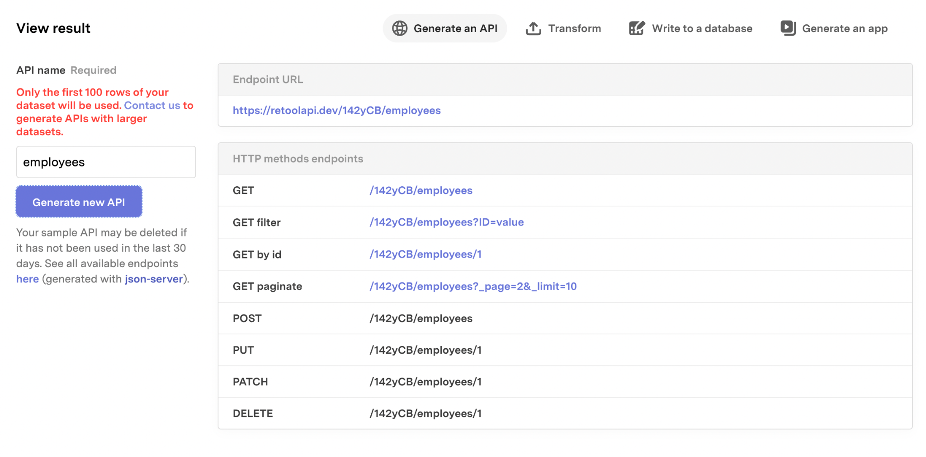
Sandbox Setup Steps
We are leveraging a cloud solution called retool for automatically generating sandbox with all mock API
The generated synthetic data CSV can be uploaded to retool to generate All CRUD REST APIs within seconds

Slide 13
Benefits
Risk Mitigation
04
Efficiency
synthetic data platform generates highly accurate synthetic behavioral data without privacy risk
Improve efficiency by eliminating manual efforts such as generating test data, masking sensitive data, etc
01
03
Data Compliance
Cost Reduction
synthetic test data can be hosted on cloud of third party sandbox solutions without risking data compliance
With sandbox provisioning, need for dedicated test environment/hardware can reduced, resulting in overall cost reduction
02

Slide 14

Thank you!
Reference: https://www.scb.se/contentassets/ca21efb41fee47d293bbee5bf7be7fb3/using-bayesian-networks-to-create-synthetic-data.pdf
Guide : DataSynthesizer-README.md
Github URL : https://github.com/vinoswe/AIHackathon

